Slide 1


Presentation Flex Box Adrien Houen

Slide 2

Once upon a time …
Native name : CSS Flexible Box Layout
Abbreviation : Flexbox
Date : 23 July 2009
98,69% of installed browsers support Flexbox
Responsive elements for the growing variety of screen sizes

Slide 3
Introduction to Flexbox Layout
Align
Distribute space
To give the container the ability to alter its items’ to best fill the available space
the flexbox layout is direction-agnostic

Slide 4
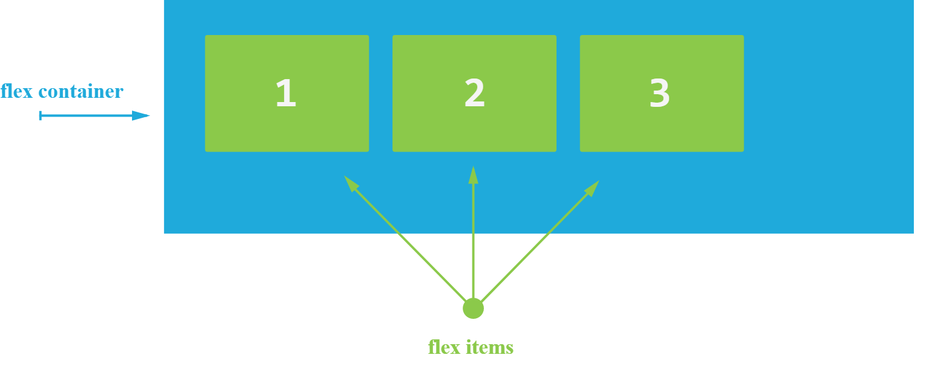
Basic

Slide 5
Flexbox properties
Properties for the Parent
(flex container)
Properties for the Children
(flex items)
Display
Flex-direction
Flex-wrap
Flex-flow
Justify-content
Align-items
Align-content
Order
Flex-grow
Flex-shrink
Flex-basis
Flex
Align-self

Slide 6
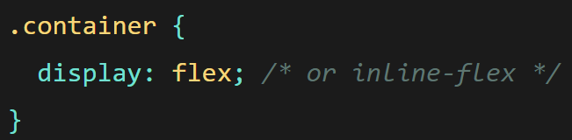
display
Transform HTML element into Flex container

Slide 7
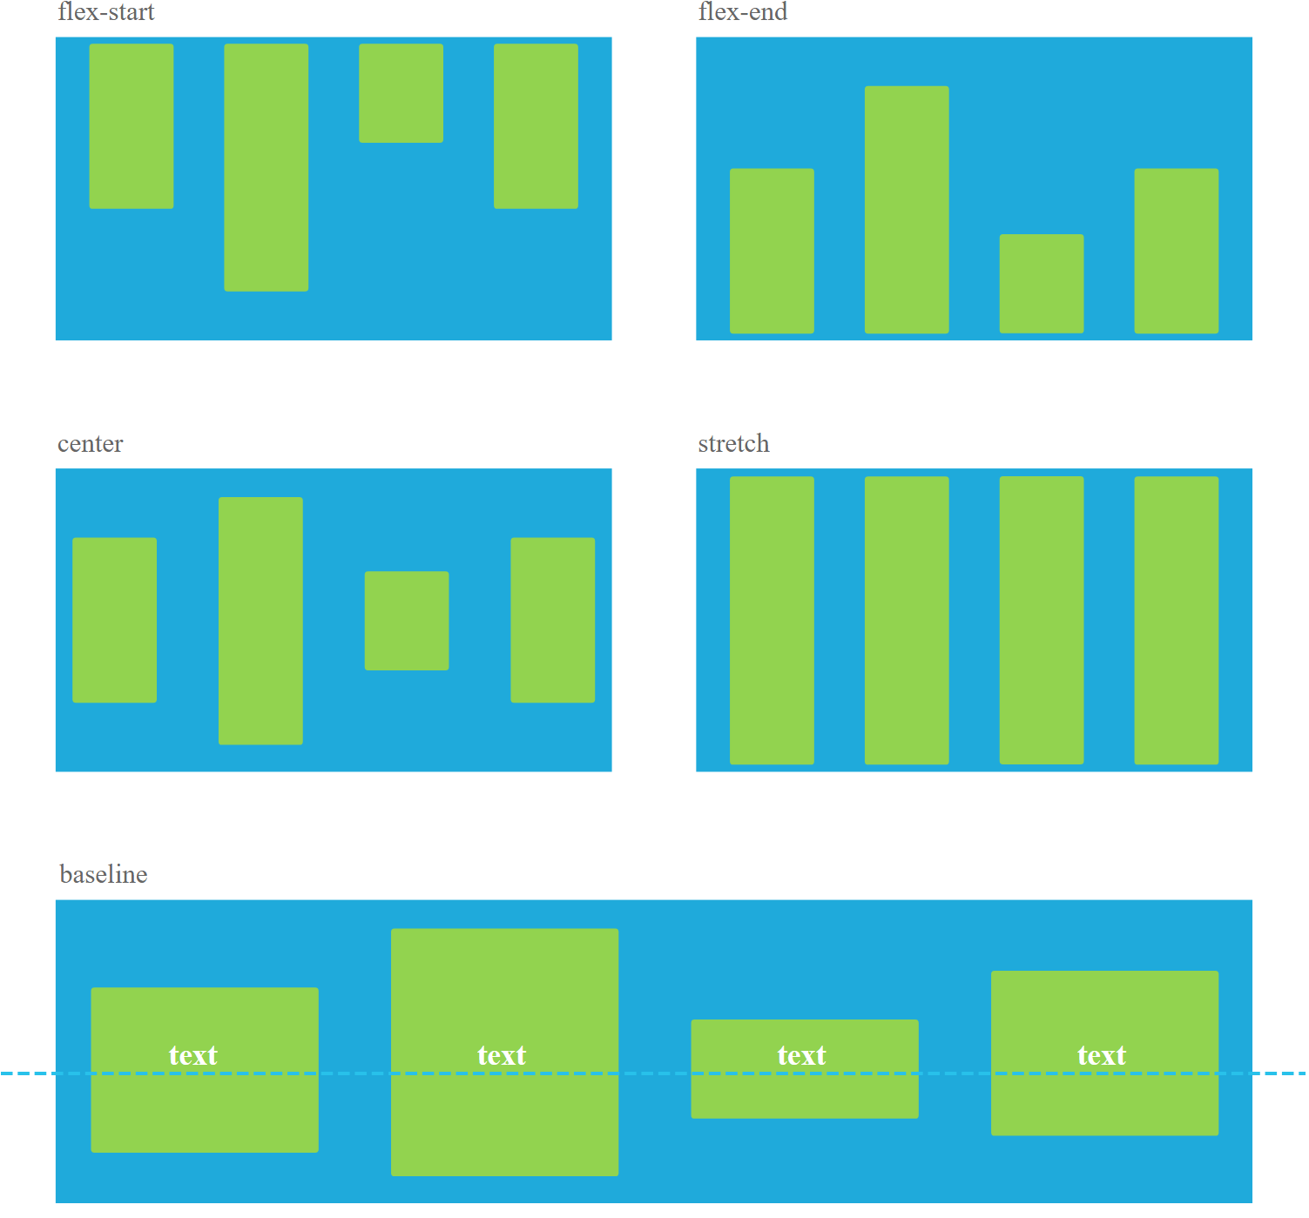
align-items
Stretch (default)
Flex-start / start / self-start
Flex-end / end / self-end
Center
Baseline

Slide 8
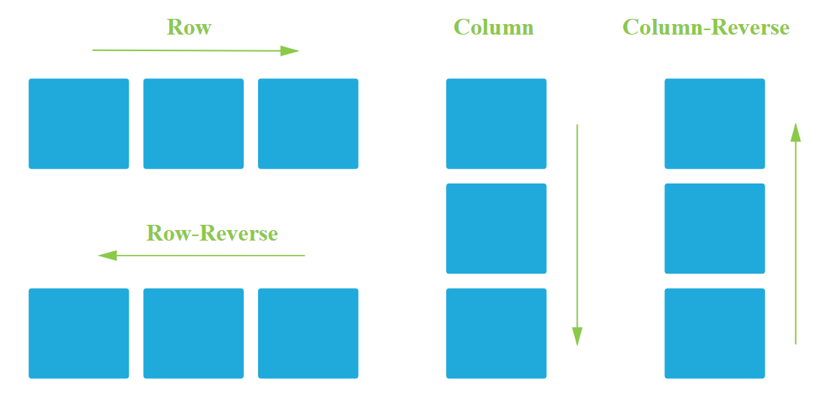
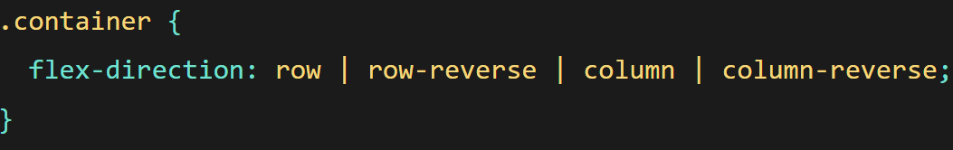
flex-direction
Row (default)
Row-reverse
Column
Column-reverse

Slide 9
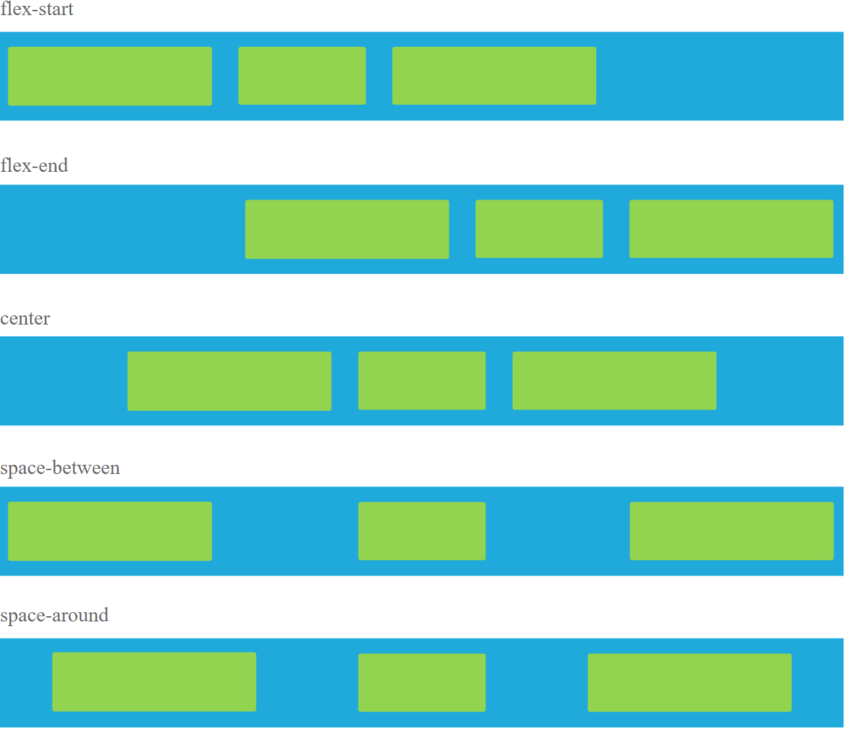
Justify-content
Flex-start (default)
Flex-end
Center
Space-between
Space-around
Space-evenly

Slide 10
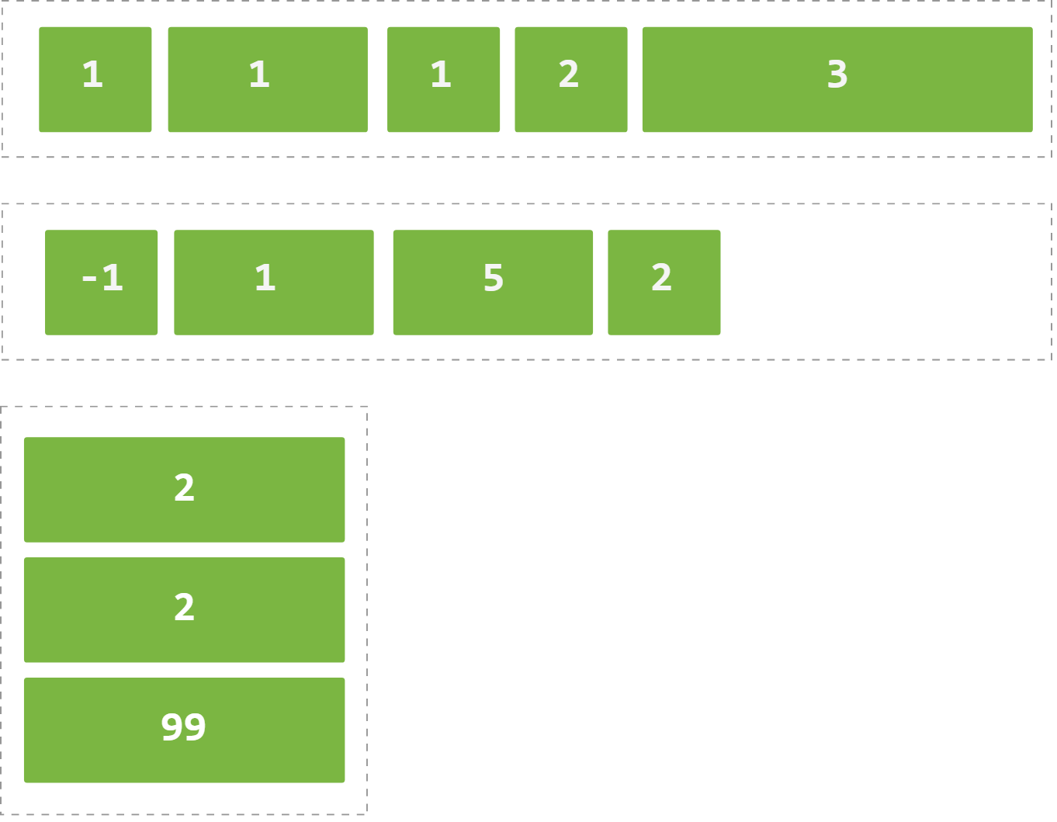
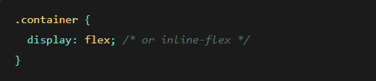
order
Default value is 0
Order by default : From lowest number to the highest
The order property change the order by default

Slide 11
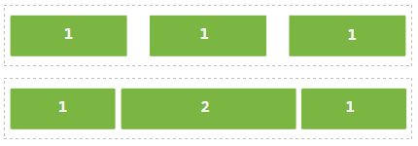



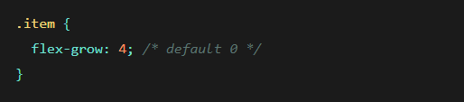
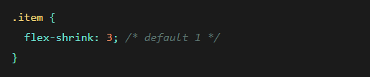
Flex-grow / Flex-shrink

Slide 12


Let’s pratice ☺

